Slide 1
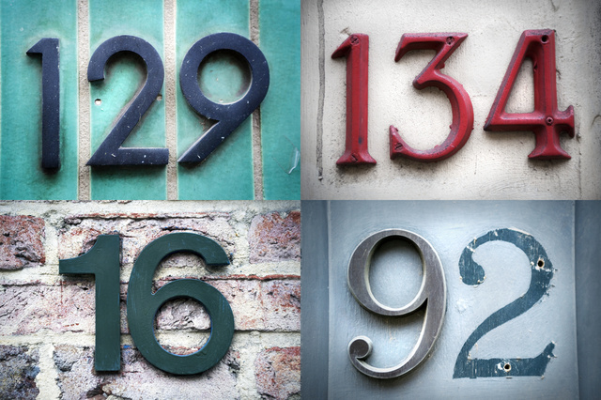
Automated
Marking System
for Choice Questions
Image Processing & Pattern Recognition
选择题自动判分系统
Xingchen Yang, Zengliang Zhao, Bin Zhang,
Haider Usman, Muhammad Javed, Muhammad Ali Mahmood
Data Mining (Spring, 2016)
Shanghai Jiao Tong University (SJTU)
Loading

Slide 2
（1）Background
（2）Methodology
（3）Progress
（4）Future work

Slide 3
（1）Background
（2）Methodology
（3）Progress
（4）Future work

Slide 4
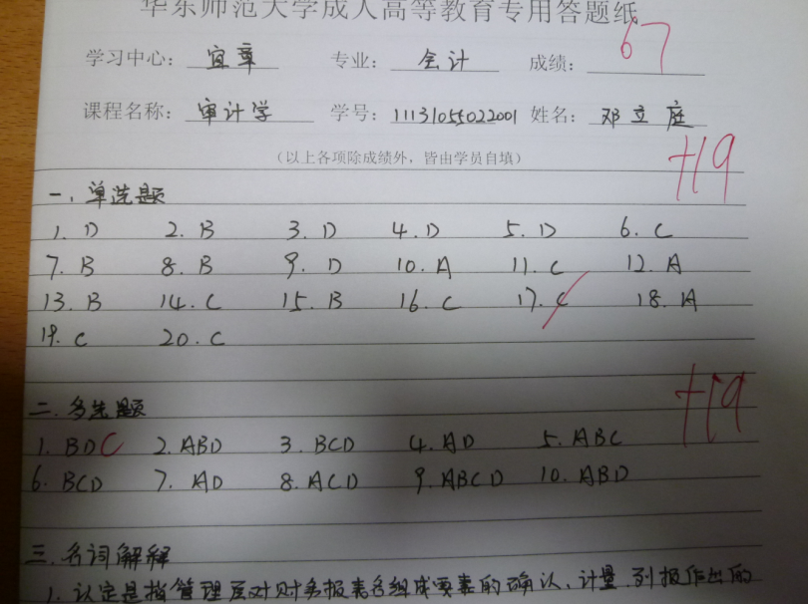
Requirements
Propose the framework and methods to mark the choice questions in the images of test papers.
Propose the methods to recognize the answers,
Propose a cognitive model to recognize the various patterns of the answers in the images.
P1030382.JPG

Slide 5
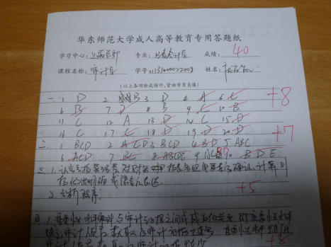
General Idea
of Project Two
Two target parts: (1) Single choice questions; (2) Multiple choice questions;
Both parts are provided with correct answers:
For single choice questions: DBDDD CBBDA CABCB CBACC
For multiple questions: BDC, ABD, BCD, AD, ABC, BCD, AD, ACD, ABCD, ABD
Raw images
pre-processing
segmentation
Output
recognition
marks

Slide 6
General Idea
of Project Two
pre-processing
Rotation, zooming in/out
Removing shadows and irrelevant characters/signs
Alignment, cropping, binarization
segmentation
Locate the target lines
Segment target characters of target choices
recognition
Selection of classifier
Training classifier with training dataset
Testing the rest with the trained classifier

Slide 7

Challenges
in Project Two
P1030359.JPG
Distortion Resulted from perspective
Red marks
Revised handwriting
Different character spacing
Irrelevant objects (desk)
Non-uniform shadows

Slide 8

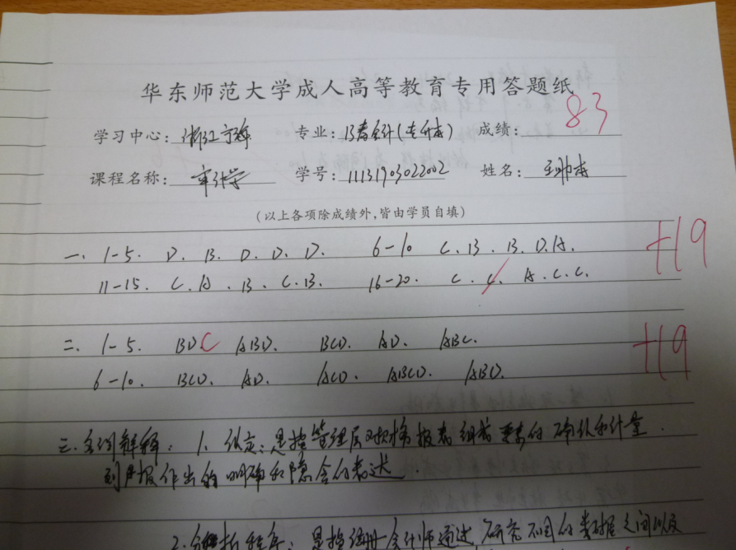
(CANT BE WORSE REALLY :< )
Challenges
in Project Two
Completely different perspective of photos
Different arrangements in answers
Different colors of handwritings
Ambiguous characters, etc.
More problems when comparing different images
P1030359.JPG
P1030379.JPG

Slide 9
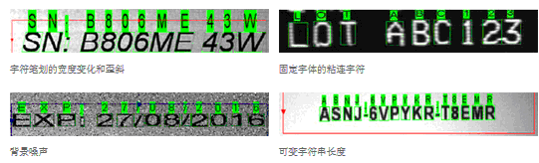
Challenges
in Project Two
Optical character recognition (optical character reader) (OCR) is the mechanical or electronic conversion of images of typed, handwritten or printed text into machine-encoded text, whether from a scanned document, a photo of a document, a scene-photo or from subtitle text superimposed on an image.
OCRMAX tool has reaches a accuracy rate at 99%.
But it only works for those characters aligned well.
The most difficult part of Project 2 lies in pre-processing and segmentation.

Slide 10
（1）Background
（2）Methodology
（3）Progress
（4）Future work

Slide 11
（1）Background
（2）Methodology
（3）Progress
（4）Future work

Slide 12
Remove Red Marks
RGB to Grayscale
Histogram Equalization
Grayscale to Binary
Segmentation
Single Character
Optical Character Recognition
Comparison with correct answers
Marks

Slide 13
（1）Background
（2）Methodology
（3）Progress
（4）Future work

Slide 14
（1）Background
（2）Methodology
（3）Progress
（4）Future work

Slide 15
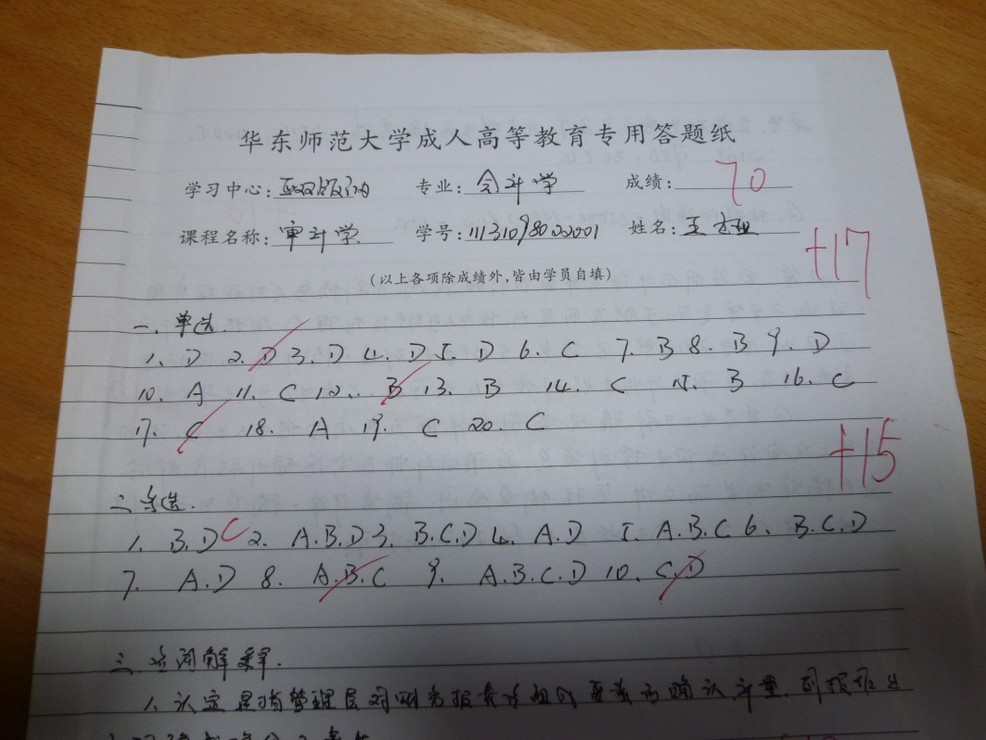
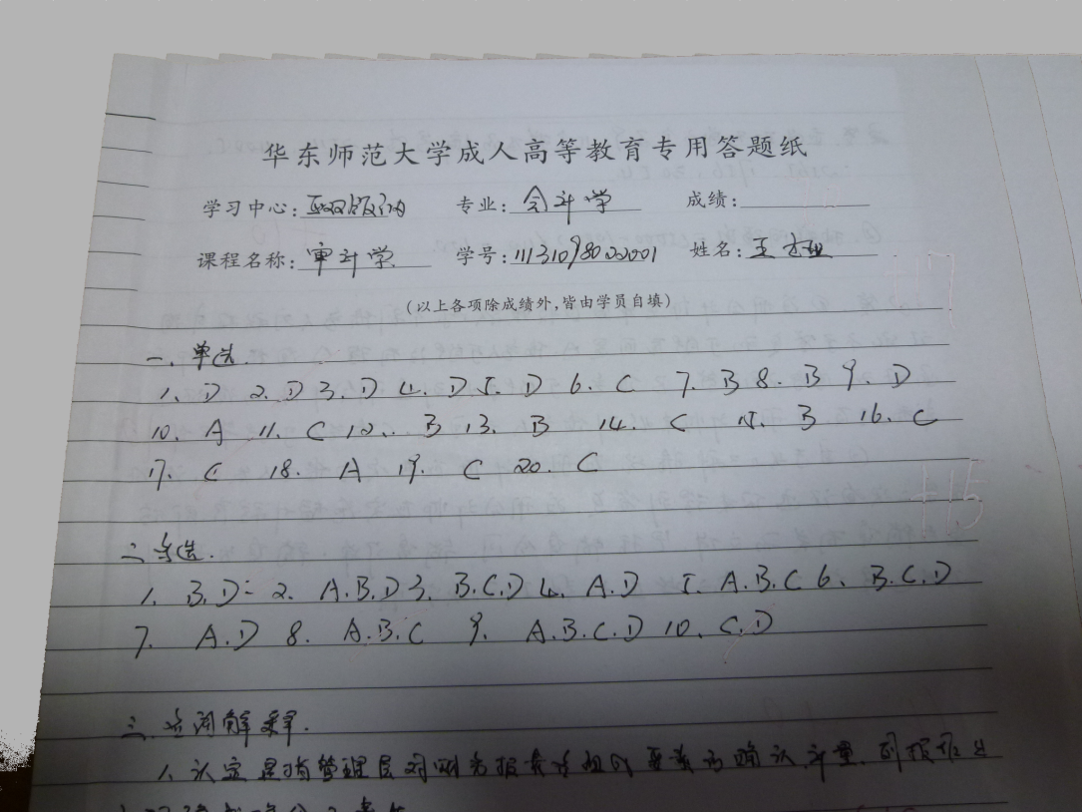
Removing red marks
Detecting red pixels
Replacing red pixels with nearby pixels

Slide 16
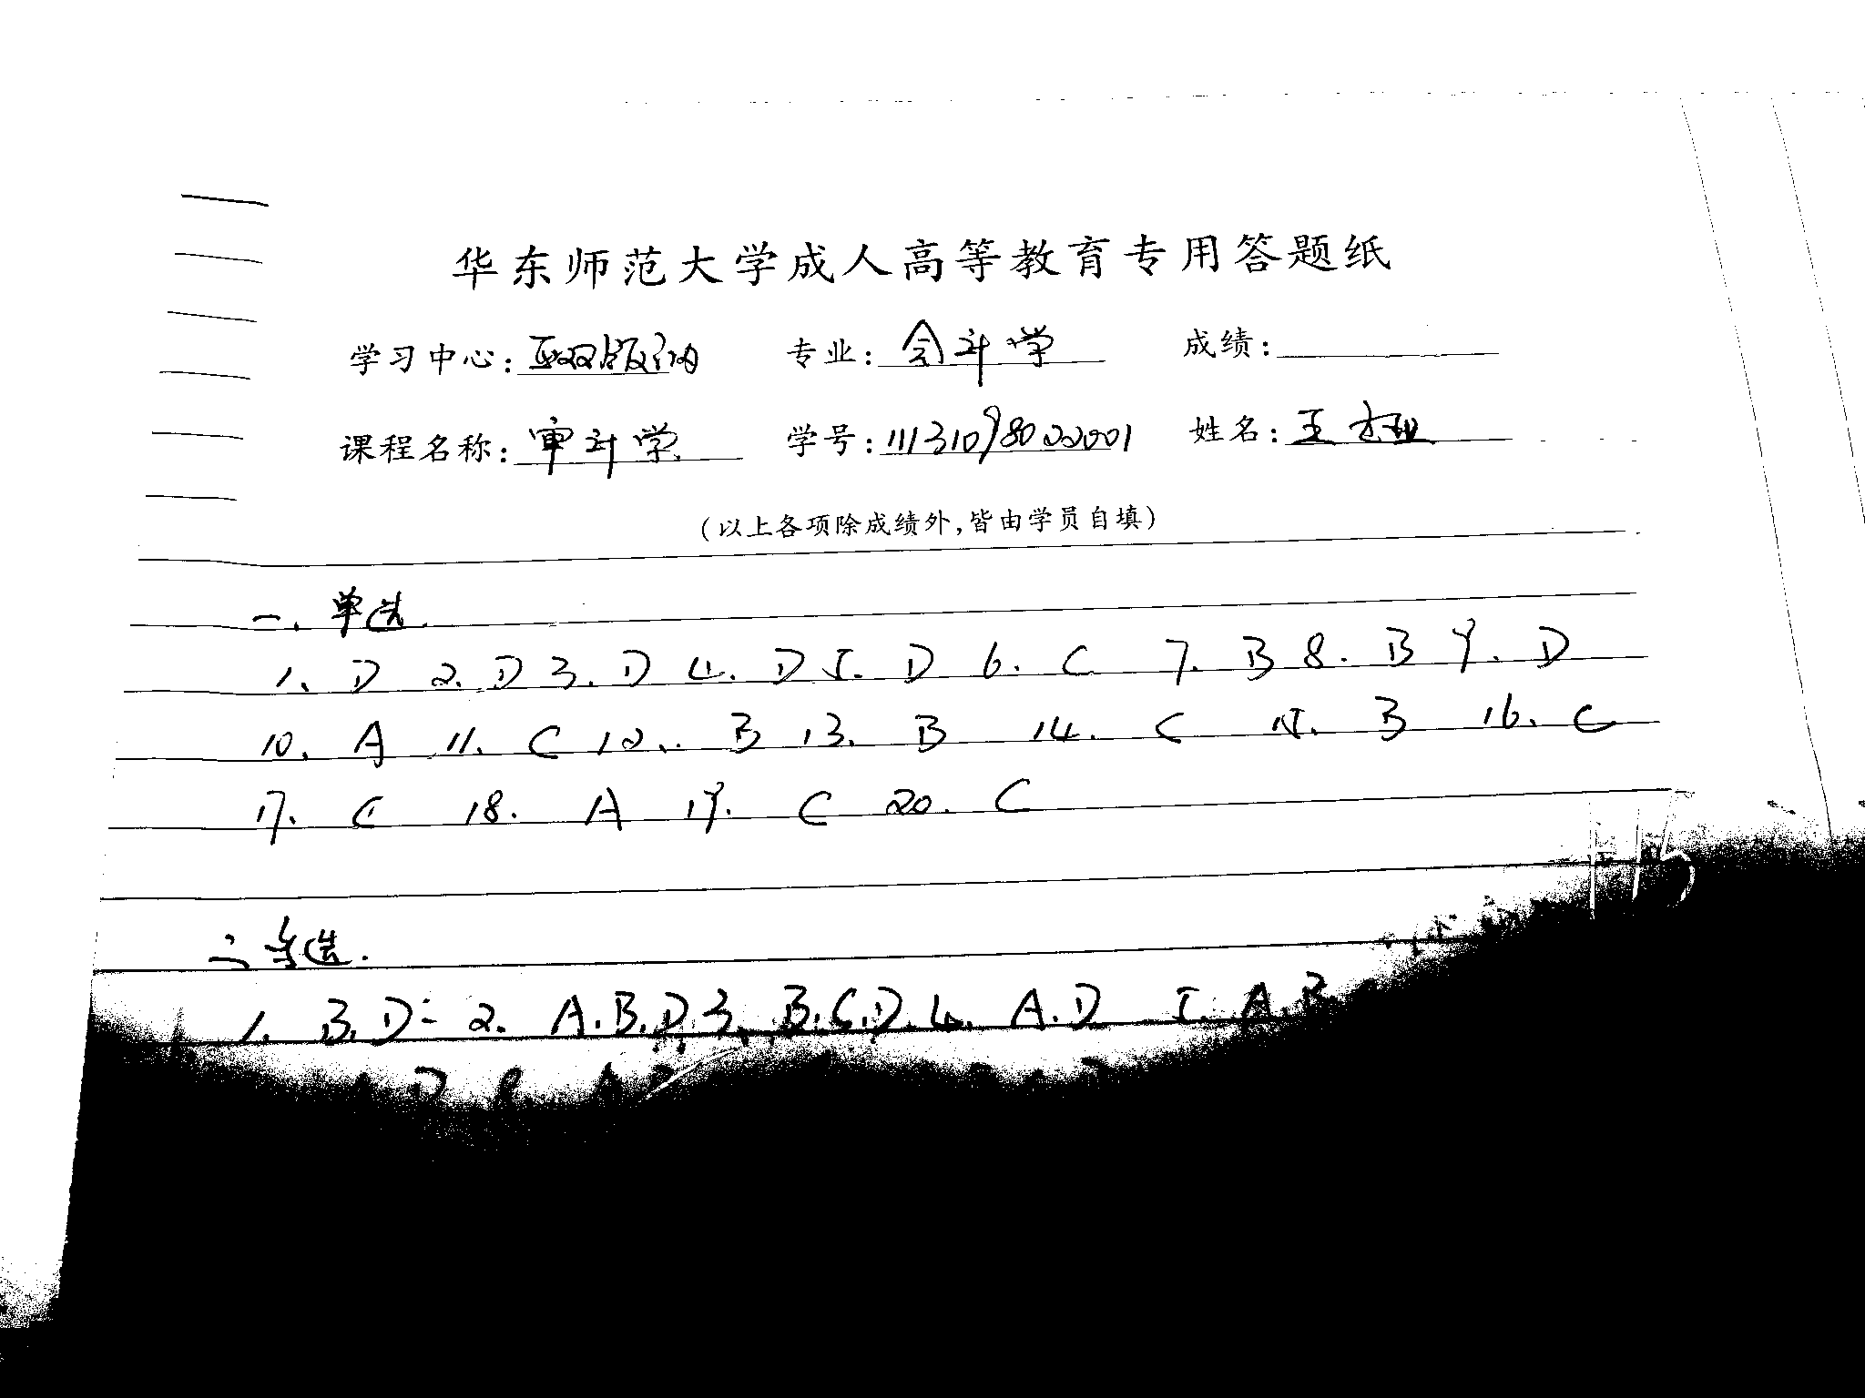
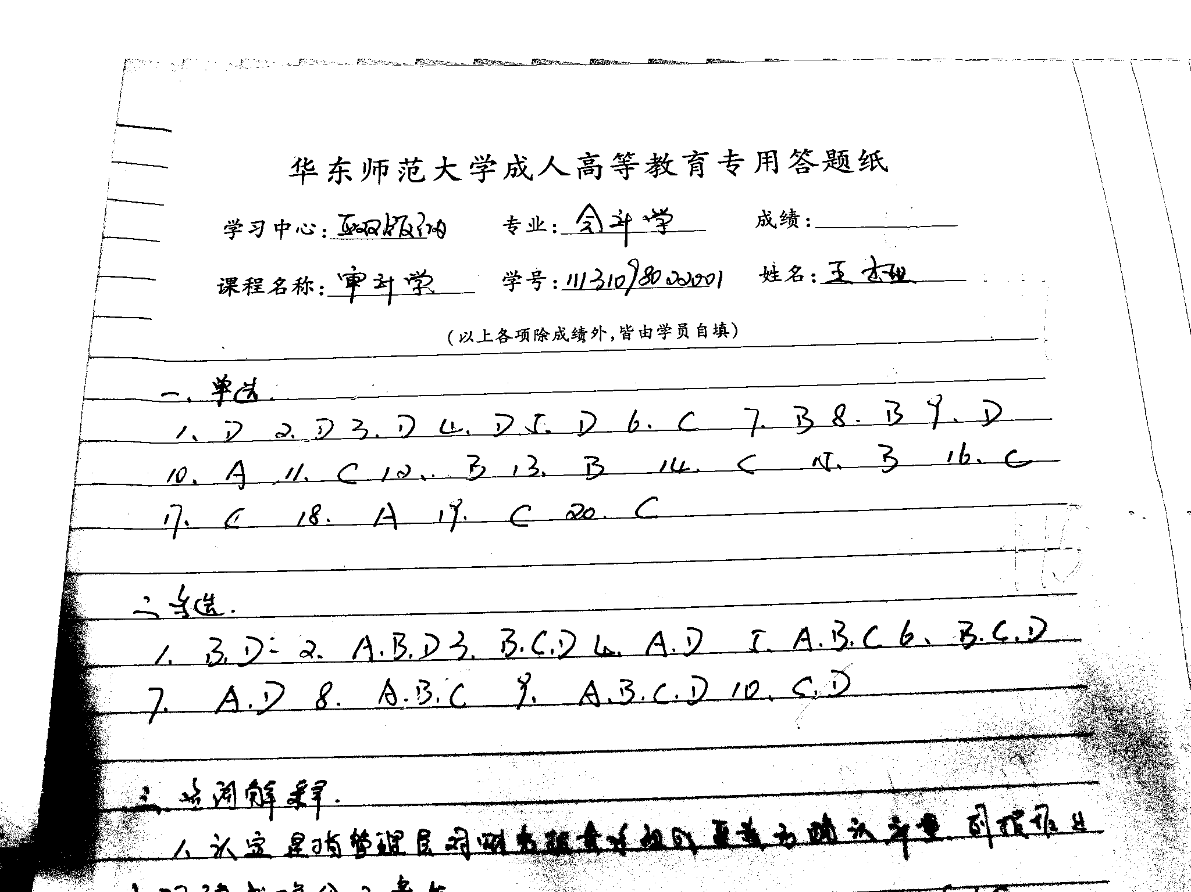
Histogram Equalization
Pixelwise threshold is computed by using the mean and standard deviation of the pixels in the surrounding regions
Before
After

Slide 17
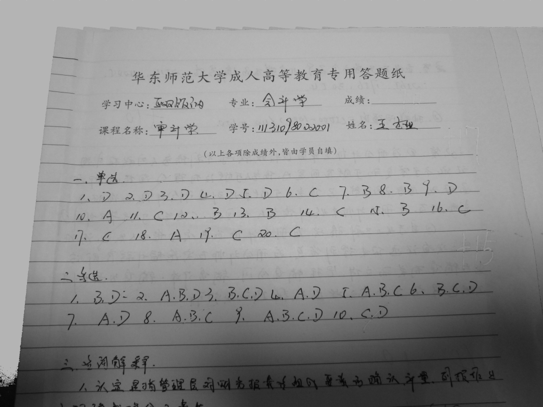
Image Binarization
Locally adaptive image threshold chosen using local first-order image statistics around each pixel.
Dilation and erosion

Slide 18
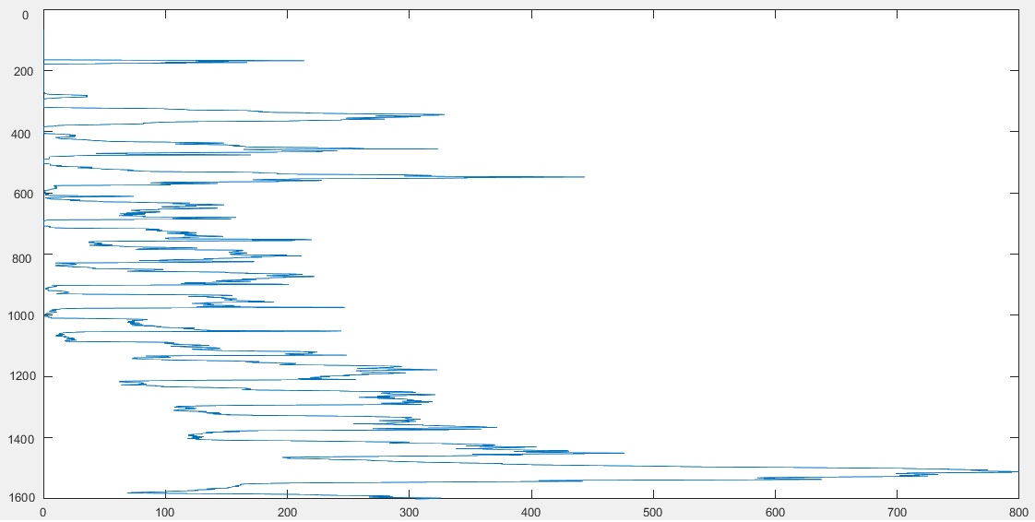
Image Segmentation
Horizontal Projection Histogram

Slide 19
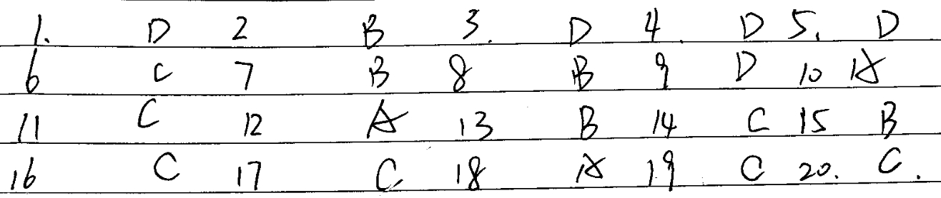
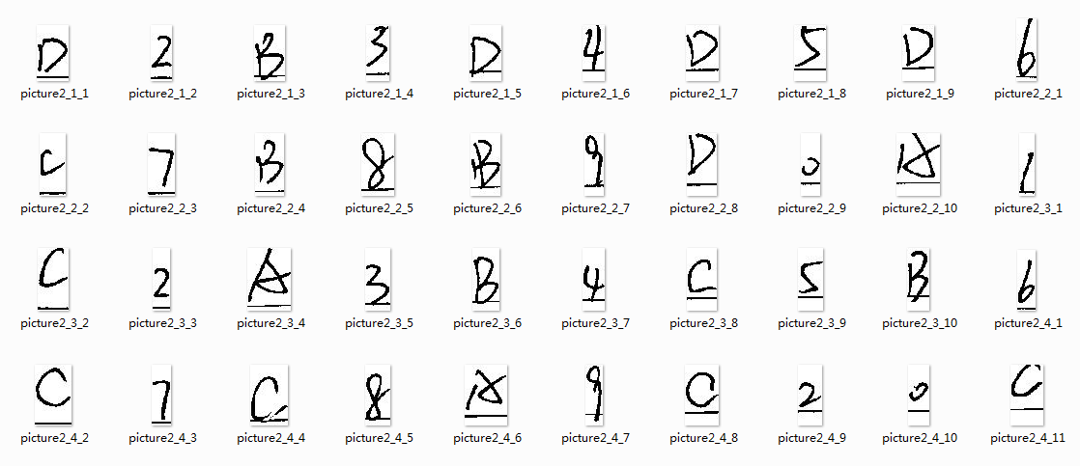
Image Segmentation
Vertical Projection Histogram

Slide 20
（1）Background
（2）Methodology
（3）Progress
（4）Future work

Slide 21
（1）Background
（2）Methodology
（3）Progress
（4）Future work

Slide 22
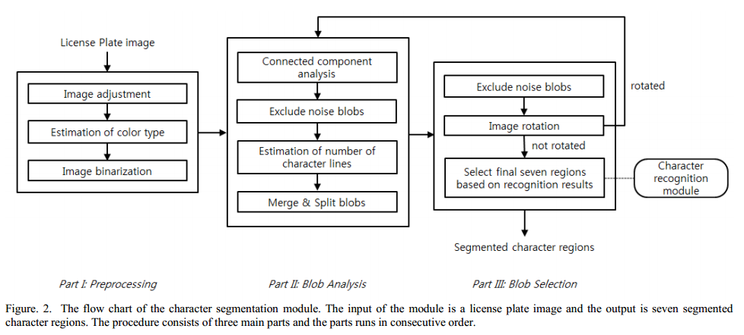
BLOB Method
for Segmentation
Yoon Y, Ban K D, Yoon H, et al. Blob extraction based character segmentation method for automatic license plate recognition system[C]//Systems, Man, and Cybernetics (SMC), 2011 IEEE International Conference on. IEEE, 2011: 2192-2196.

Slide 23
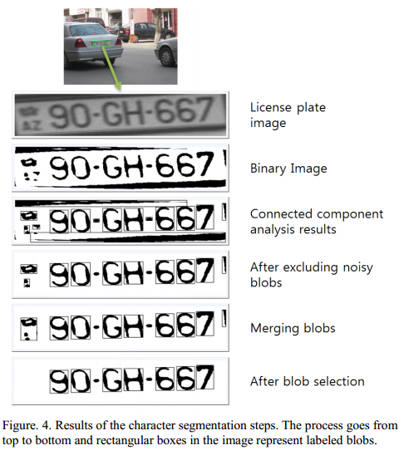
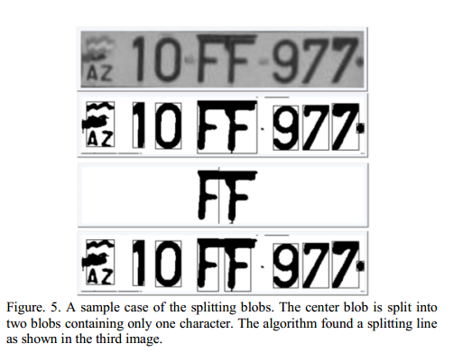
BLOB Method
for Segmentation
Yoon Y, Ban K D, Yoon H, et al. Blob extraction based character segmentation method for automatic license plate recognition system[C]//Systems, Man, and Cybernetics (SMC), 2011 IEEE International Conference on. IEEE, 2011: 2192-2196.

Slide 24
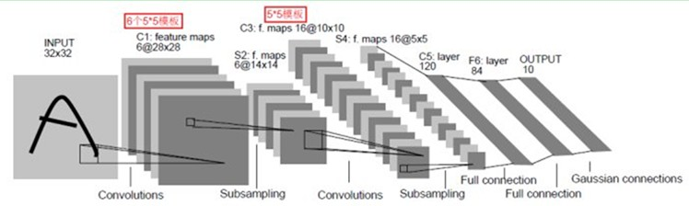
LeNet-5
CNNs
Convolutional Neural Networks are are a special kind of multi-layer neural networks.
Convolutional Neural Networks are designed to recognize visual patterns directly from pixel images with minimal preprocessing. They can recognize patterns with extreme variability (such as handwritten characters), and with robustness to distortions and simple geometric transformations.
LeNet-5 is the latest convolutional network designed for handwritten and machine-printed character recognition.

Slide 25

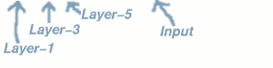
LeNet-5
CNNs
Convolutional Neural Networks are are a special kind of multi-layer neural networks.
Convolutional Neural Networks are designed to recognize visual patterns directly from pixel images with minimal preprocessing. They can recognize patterns with extreme variability (such as handwritten characters), and with robustness to distortions and simple geometric transformations.
LeNet-5 is the latest convolutional network designed for handwritten and machine-printed character recognition.
AN EXAMPLE ->

